Slide 1

Unit 1: Operational Amplifier Characteristics
Active Filters
Pre – preparation: Lecture Materials and LIC Text book by ROY Choudhury, sixth edition, 2022.

Slide 2
Unit 5: Introduction Filters
A filter is a circuit that allows desired frequencies to pass and attenuates unwanted frequencies.
Filters are of two types: analog and digital; analog filters are further classified as passive and active.
Passive filters use R, L, C components, while active filters use op-amps with resistors and capacitors, reducing loading effects.
Filters are widely used in communication and signal processing for noise reduction, interference suppression, bandwidth control, and signal shaping.

Slide 3
Unit 5: Limitations of Passive Filters
In RLC networks, the practical inductors tend to deviate from the inductance realised.
There is a power loss because of the dissipation in resistive and inductive elements of the passive network.
For most practical inductors, the total dissipative losses tend to increase with frequency, since Q does not increase linearly with frequency.
At low frequency (less than 1 kHz) applications such as control systems and analog computers, practical inductors of reasonable Q tend to become bulky and expensive.
The magnetic coupling creates additional problem in the form of unwanted and stray field which is harmful for applications such as satellite instrumentation.
The dissipative losses start increasing when an inductor is miniaturised. The Q of a lowfrequency inductor is roughly proportional to the square of the scaling factor.

Slide 4
Unit 5: Advantages of Active Filters
The maximum value of the transfer function or gain may be greater than unity (passive<=1).
The loading effect is minimal, which means that the output response of the filter is essentially independent of the load driven by the filter.
The active filters do not exhibit insertion loss. Hence, the passband gain is equal to 0dB or higher.
Active filters replace inductors with op-amps + RC networks.
Inductors become impractical at low frequencies. Passive networks can only be practically realized for high frequencies. Active filters solve this.
The active filters are easily tunable due to flexibility in gain and frequency adjustments.
The op-amp has high input impedance and low output impedance. Hence, the active filters using op-amp do not cause loading effect on the source and load. Therefore, cascading of networks does not need buffer amplifier.
Active filters can be made tunable using control voltage or variable components.

Slide 5
Unit 5: Limitations of Active Filters
The high frequency response is limited by the gain-bandwidth product and slew rate of the practical op-amps, leading to comparatively lower bandwidth than the designed bandwidth.
The design of active filters becomes costly for high frequencies. Require high slew rate Op-amps.
Active filters require dual polarity dc power supply whereas passive filters do not. Passive filter works purely on input signal. Whereas, Op-amp needs external power supply to work.
The active element is prone to the process parameter variations and they are sensitive to ambient conditions like temperature. Hence, the performance of the active filter deviates from the ideal response.

Slide 6
Unit 5: Comparison of Active and Passive Networks
Feature Passive | RLC Network | Active RC network
Realisability | Can realise only a class of real rational functions which are analytic in the right half of rational s-plane | No restrictions. Can realize any real function
Requirement of inductors | Inductors are required in almost all cases | Inductors are not required
Applicability | Used for applications frequency response | Can be used both for fixed and variable frequency response type applications
Frequency range | Above 200 Hz | Below 100 kHz
Signal source | Suitable only for resistive source impedances. The low impedance source must be capable of supplying enough signal power. | High input impedance can be achieved with the use of op-amps. Hence, filter is independent of source impedance. Operates with lower signal power.
Load impedance | Suitable only for resistive load impedances. Filter operation depends mainly on load impedance. | Very low output impedance can be achieved. Hence, filter operation is independent of load impedance.
Buffer amplifiers | Buffer amplifier is required, resulting in increased number of stages. | Additional buffers are not required due to good impedance matching characteristics.

Slide 7
Unit 5: Comparison of Active and Passive Networks
Feature Passive | RLC Network | Active RC network
Insertion loss | Insertion loss is significantly high. Hence, additional amplification is required. | Insertion gain control can be made. Hence, additional amplifiers are not required.
Micro-miniaturisation | Since inductors play a role, miniaturisation and integration are not possible. | Resistors and capacitors being replaced by MOS devices result in miniaturisation to the order of 65 nm feature sized devices
Stability | Absolutely stable | Instability may arise due to varying process conditions in fabrication. Stability margin can be improved by more accurate process conditions.
Sensitivity | The ladder type filter is less sensitive. | More sensitive
Power supplies | Does not require any power supplies | Dual power supplies are required to bias the active elements.

Slide 8
Unit 5: Active Filter Design
The manner in which the behaviour of the filter varies with frequency is called its frequency response and it is expressed in terms of the transfer function H(jw)
Low Pass Filter: A low-pass filter allows only low frequency signals up to a certain break-point f_{H} to pass through, while suppressing high frequency components. Frequencies from 0 to f_{H} is called passband and else is called stopband
High Pass Filter: A high-pass filter allows only frequencies above a certain break-point f_{L} to pass through and attenuates the low frequency components. Frequencies from 0 to f_{L} is called stopband and else is called passband
Bandpass Filter: The bandpass filter is the combination of high and low-pass filters, and this allows a specified range of frequencies to pass through.
Band Reject Filter: The band-reject filter is the logical inverse of bandpass filter, which does not allow a specified range of frequencies to pass through.

Slide 9
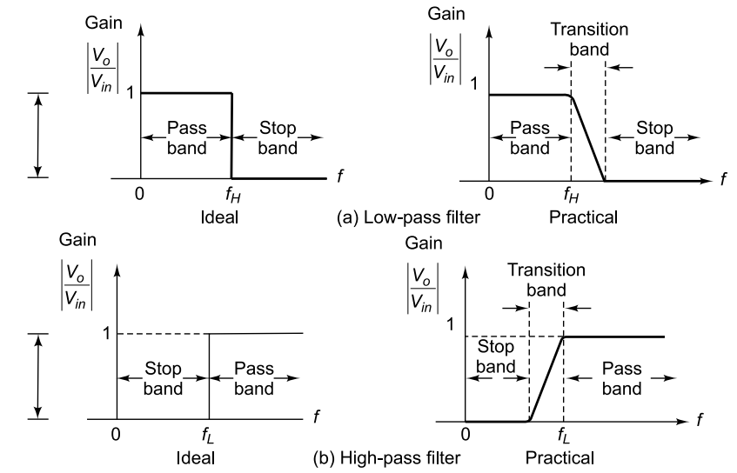
Unit 5: Active Filter Design

Slide 10
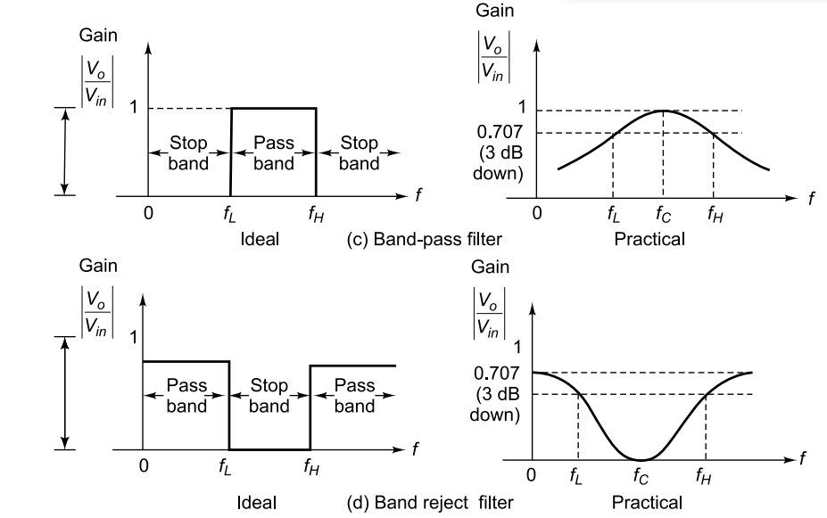
Unit 5: Active Filter Design

Slide 11
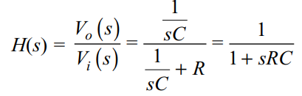
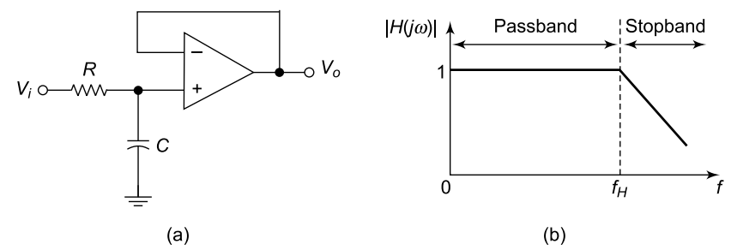
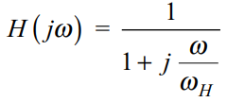

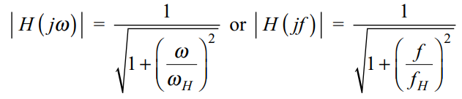
Unit 5: First Order Low Pass Filters with Unity Gain
The slope of the voltage gain magnitude curve outside the passband is 6 dB/octave or 20 dB/decade. This characteristic is called the roll-off. The roll-off becomes sharper or steeper with higher-order filters.

Slide 12

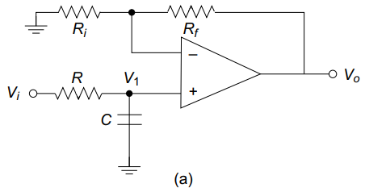


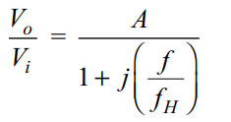
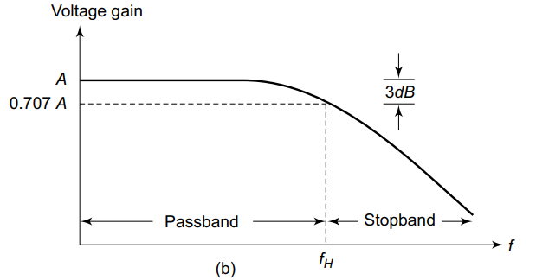
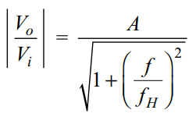
Unit 5: First Order Low Pass Filters with Variable Gain

Slide 13

Unit 5: First Order Low Pass Filters with Variable gain
At very low frequencies, i.e. f < f_{H}, the gain is nearly A. When the frequency reaches the cut-off frequency, i.e. f = f_{H}, the gain falls to 0.707 times the maximum gain A.
At high frequencies, i.e. f > f_{H}, the gain decreases at a constant rate of –20 dB/decade. The frequency range beyond f_{H} is called stopband.
Low pass filter Design:
Choose the value of high cut-off frequency f_{H}
Select the value of capacitor C such that its value is <1 uF.
When the values f_{H} and C are known, the value of R can be calculated by using f_{H} = 1/(2*pi*R*C).
Finally, select the values of R_{i} and R_{f} depending on the desired passband gain by using

Slide 14
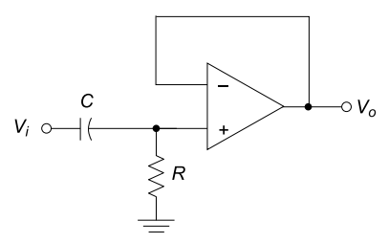
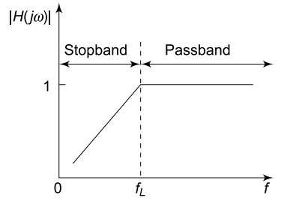
Unit 5: First Order High Pass Filters with Unity Gain

Slide 15
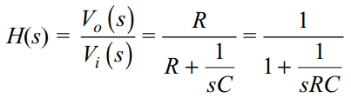
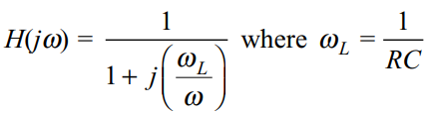
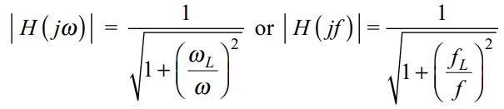
Unit 5: First Order High Pass Filters with Unity Gain

Slide 16

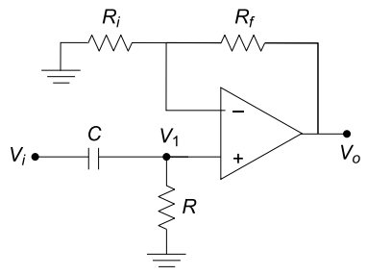
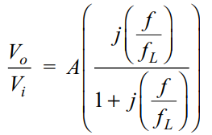
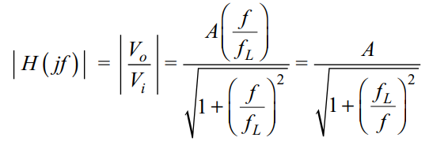
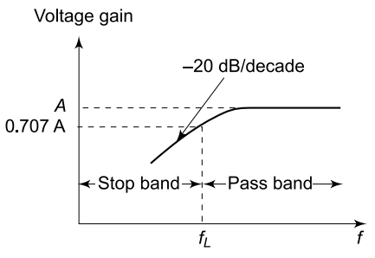
Unit 5: First Order Low Pass Filters with Variable Gain

Slide 17
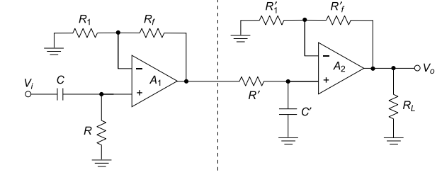
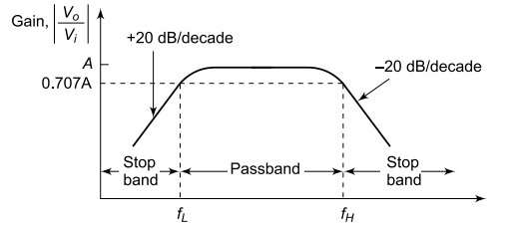
Unit 5: First Order Band Pass Filters
A band-pass filter is formed by cascading a low-pass and a high-pass filter.
The low-pass section passes frequencies up to fH​, while the high-pass blocks below fL​
Proper operation requires fH>fL​, typically fH≥10*fL for a clear passband.
Both sections must have equal passband gain to ensure uniform response in the band fL​ to fH​.
A ±20 dB/decade band-pass filter is realized using first-order high-pass and low-pass sections with op-amps.
Higher roll-off (±40 dB/decade) is achieved by cascading second-order filter sections for sharper selectivity.

Slide 18
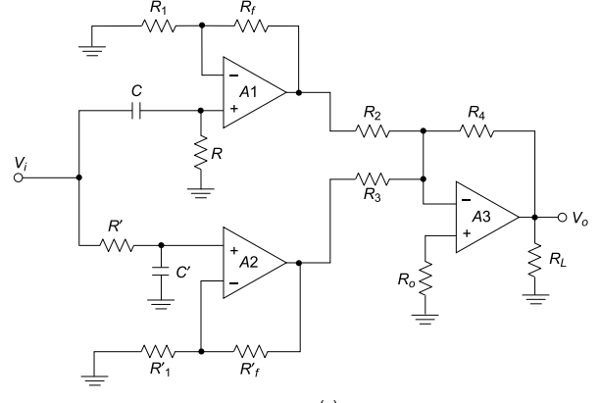
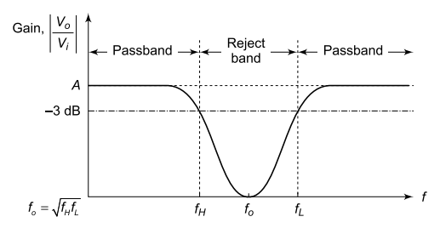
Unit 5: First Order Band Reject Filters

Slide 19
Unit 5: First Order Band Reject Filters
A band-reject (band-stop) filter is formed by connecting a low-pass and high-pass filter in parallel.
The inputs are applied in parallel, and outputs are combined using a summing circuit to prevent loading.​
The low-pass section blocks frequencies above f_{H}, while the high-pass blocks below f_{L}​.
Proper operation requires f_{L}​>f_{H}​, creating a stopband​.
The resulting output passes frequencies outside this range and rejects those within the stopband.
A wideband band-reject filter is realized by paralleling HPF (fL​) and LPF (fH​) with a summing amplifier.
The summing amplifier adds outputs of both sections to produce the final band-reject response.
Equal passband gain in both HPF and LPF sections is necessary for proper filter performance.
The frequency response shows attenuation in the band fH​ to fL​ and passbands on either side.
For unity gain design, resistors satisfy 𝑅2=𝑅3=𝑅4 ​.

Slide 20
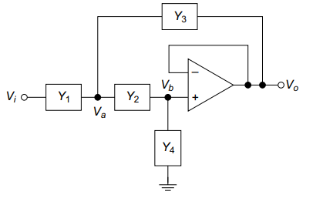

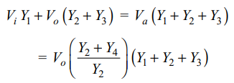



Unit 5: Higher Order Filters
A second-order active (Sallen-Key) filter uses admittances 𝑌1-Y4 ​ with a voltage follower to eliminate loading due to high input and low output impedance.
A non-inverting amplifier configuration can be added to increase gain while maintaining isolation between stages.
KCL at node Va
​.
Applying KCL at node

Slide 21
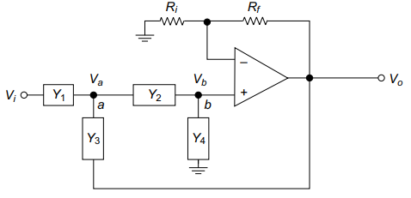






Unit 5: Higher Order Filters
Applying KCL at node Va
Applying KCL at node Vb

Slide 22
Unit 5: Higher Order Filters
Applying KCL at node Va
Applying KCL at node Vb

Slide 23
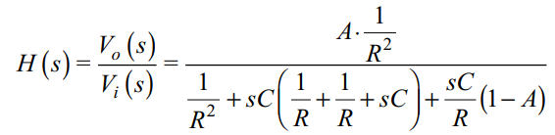
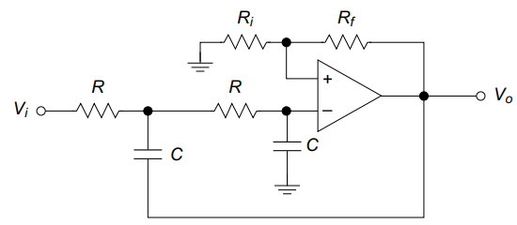
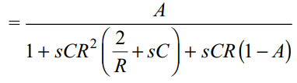

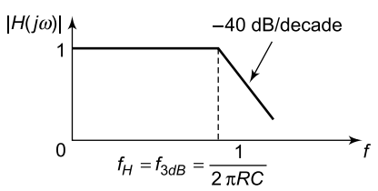

Unit 5: Second Order Low Pass Filters
When s = 0, H(0) = A ; when s = ∞, H(∞) = 0, which indicates that this configuration is for low-pass active filters.

Slide 24



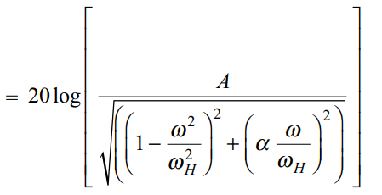

Unit 5: Second Order Low Pass Filters
For second order physical systems such as electrical, mechanical, chemical and hydraulic, the transfer function can be expressed as
The normalised expression for low-pass filter is given by
Magnitude response is given by

Slide 25

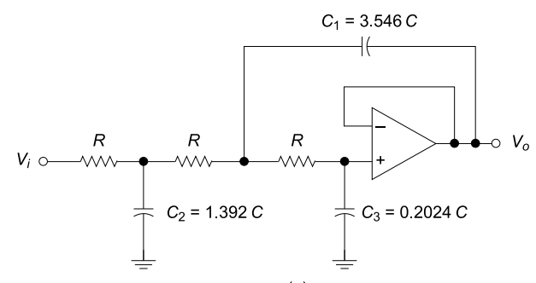
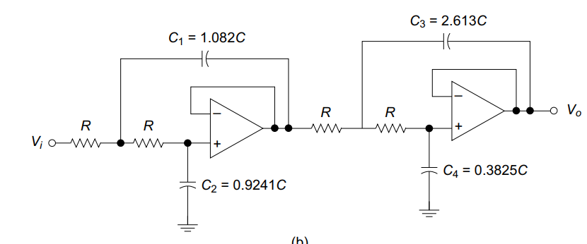
Unit 5: Second Order Low Pass Filters
Higher order filters can be designed by adding additional RC networks, that is, by cascading a required number of first and second order filters. The transfer function of higher order filters will be of the type, as given by

Slide 26
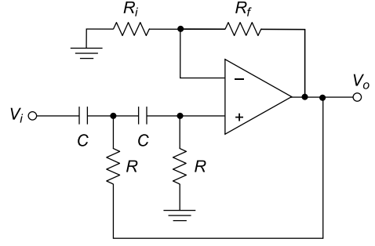
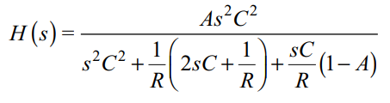
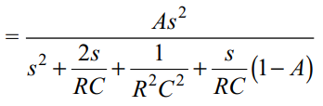
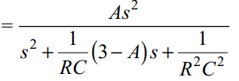

Unit 5: Second Order Low Pass Filters
Substituting the admittance values in generalized expression we get

Slide 27
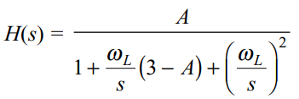

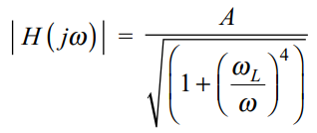
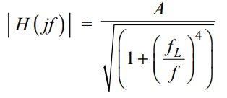
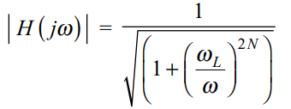
Unit 5: Second Order Low Pass Filters
Substituting the admittance values in generalized expression we get
For unity gain system

Slide 28
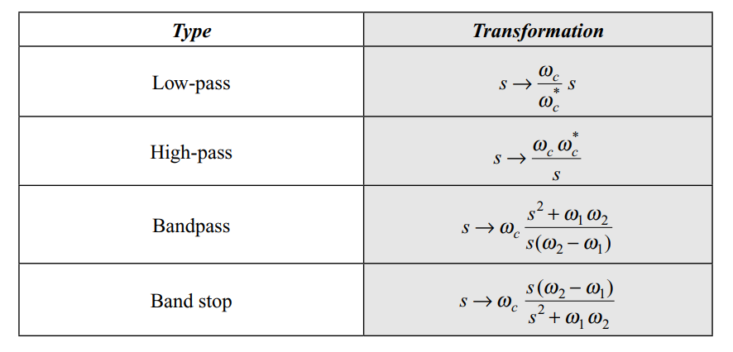
Unit 5: Frequency Transformations
A low-pass filter is usually designed first and used as a prototype.
Instead of designing every filter from scratch, frequency transformation is used. It helps convert the low-pass filter into other types easily.
In analog frequency transformation, the prototype function 𝐻𝑝(𝑠) is modified. This gives a new function 𝐻(𝑠) for the required filter.

Slide 29
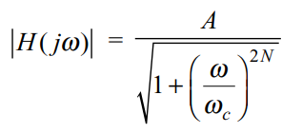
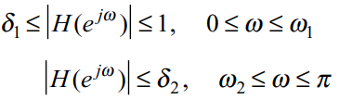
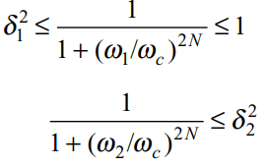
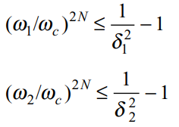
Unit 5: Butterworth Filters
The magnitude response of butterworth filter is given as
The specifications for the filter response are as follows

Slide 30

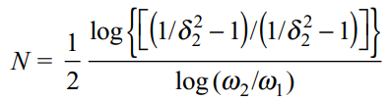
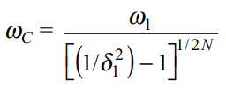


Unit 5: Frequency Transformations
After deciding the order of filter. It is now time to decide the cutoff frequency.
The general transfer function of a butterworth filter is given as
or

Slide 31
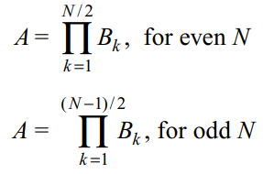
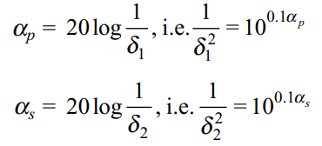
Unit 5: Frequency Transformations
If pass band and stopband attenuation are given in dB then
The general transfer function of a butterworth filter is given as

Slide 32

Unit 5: Frequency Transformations
The butterworth polynomial are given as:

Slide 33

Unit 5: Chebyshev Filters
It accepts a controlled amount of ripple (oscillation) in the passband in exchange for a significantly steeper transition from passband to stopband compared to a Butterworth filter of the same order.
A Butterworth filter achieves a maximally flat passband (no ripple at all) but requires a higher order to achieve the same stopband attenuation as a Chebyshev.

Slide 34


Unit 5: Chebyshev Filters
The Magnitude Response Equation:

Slide 35


Unit 5: Chebyshev Filters
How the Denominator Controls the Response Shape:
Inside the Passband (ω ≤ ωc): C_N oscillates between −1 and +1, so C_N² is between 0 and 1.
Denominator oscillates between sqrt(1+0) = 1 and sqrt(1+ε²). Response oscillates between A (maximum) and A/sqrt(1+ε²) (minimum).
This bounded oscillation is the equiripple behaviour.
Inside the Stopband (ω > ωc): C_N grows without bound (exponentially fast) as ω increases.
Denominator becomes very large, driving |H| rapidly toward zero.
This explosive growth is what gives Chebyshev its sharp roll-off.
The larger N is, the faster C_N grows and the sharper the cut-off frequency roll off.

Slide 36




Unit 5: Chebyshev Filters
The design parameters of the Chebyshev filter are obtained by considering the low-pass filter with the desired specifications as given by
At cut-off frequency w=wc, Cn(1)=1

Slide 37



Unit 5: Chebyshev Filters
The order of the filter N can be obtained by takin wc=w1:

Slide 38


Unit 5: Elliptic Filters
Elliptic (Cauer) filters are filters with equiripple behavior in both passband and stopband, meaning controlled oscillations occur in both regions.
The key objective of elliptic filters is to achieve the sharpest transition between passband and stopband.
The magnitude response is given by
The parameter 𝜖 determines the amount of passband ripple. A larger value increases ripple but also sharpens the cutoff.
The function 𝑈_{𝑁}(⋅) represents a Jacobian elliptic function, elliptic filters are mathematically advanced.
Their major advantage is minimum order for given specifications. This reduces hardware complexity in many applications.
Unlike Butterworth and Chebyshev filters, elliptic filters have both poles and transmission zeros. These zeros are typically placed on the imaginary axis.

Slide 39
Unit 5: All Pass Filters
An all-pass filter allows all frequency components to pass with unity gain. It modifies only the phase response without affecting amplitude.
The primary function is to introduce a controlled phase shift across frequencies. This makes it useful for phase alignment and signal timing correction.
All-pass filters are also called delay equalisers, phase correctors, or constant delay filters.These names reflect their role in maintaining amplitude while altering phase.
Basic phase lag and phase lead circuits act as simple all-pass filters. This occurs when feedback and input resistances are equal (Rf = R1).
Unlike fixed-phase circuits (inverting amplifier, integrator, differentiator etc), all-pass filters provide adjustable phase shift.
They are widely used in communication systems for phase equalization. This ensures signal integrity without altering amplitude characteristics.
The transfer function typically has zeros that are mirror images of poles. This symmetry ensures constant magnitude response across all frequencies.

Slide 40
Unit 5: State Variable Filters
State-variable filter (SVF) is a versatile second-order active filter. From one circuit, you can obtain high-pass, band-pass, low-pass, and notch outputs.
It is also called a universal filter because the same topology gives multiple responses. The circuit uses two integrators and one summing amplifier.
The resistors R and capacitors C are the timing elements. They mainly set the natural frequency of the filter.
The feedback network controls the damping factor 𝑎. Equivalently, it controls Q, so tuning and selectivity can be adjusted separately.
A major advantage is electronic tuning over a wide frequency range. You can change frequency without destroying the filter structure.
Another advantage is independent adjustment of 𝑄 and 𝜔0​. That is a big practical advantage over many other second-order filters.
The band-pass output is taken from the first integrator stage.
The low-pass output is obtained after the second integrator.
The notch output is formed by summing the high-pass and low-pass signals.

Slide 41





Unit 5: State Variable Filters
A1 → Summing amplifier
A2 → First integrator
​A3 → Second integrator
A4 → Final summer
Output of first integrator:
After normalization (RC=1):
Output of second integrator:

Slide 42






Unit 5: State Variable Filters
Summing amplifier (A3) stage:
Assuming Rf=R3:
Replace

Slide 43





Unit 5: State Variable Filters
Standard response of high pass filter is
we get, A = -1 and wL = 1 for the high-pass filter operation of the state-variable filter.
Low pass transfer functions can be obtained from high pass response as

Slide 44


Unit 5: State Variable Filters
Notch filter response is given as:

Slide 45
Unit 5: Switched Capacitor Filters
Switched capacitor (SC) filters are discrete-time filters that replace resistors using capacitors and switches.
Earlier continuous-time filters relied on R, C, and op-amps. Their performance depended on absolute values of resistors and capacitors, which are inaccurate in CMOS.
In CMOS technology, resistors occupy large chip area and have poor tolerance. Capacitors, however, have much better matching accuracy, making them preferable.
The fundamental idea is that a switched capacitor behaves like a resistor.This equivalent resistance depends on clock frequency and capacitance.
When a capacitor is switched between two nodes, it transfers charge periodically. This creates an average current equivalent to resistive current flow.
This is the key principle of SC filters: resistors are replaced by capacitors + MOS switches + clock signals.

Slide 46




Unit 5: Switched Capacitor Filters
In SC-I, a capacitor alternately connects between two nodes. It charges to one voltage and discharges to another.

Slide 47



The second form of switched capacitor is shown in Fig.
In this arrangement, during the ON period of switch S1, the capacitor C is charged with respect to voltage V1. When S1 is OFF and S2 is ON, the effective charge C(V1 - V2) is transferred. This delivery of charge occurs for every sampling interval Tck. Thus, the average current i flowing through the capacitor C is given by,

Slide 48




The

Slide 49
To summarise the features of SC integrator,
(i) there are no resistors involved as necessitated for IC fabrication.
(ii) the unity gain frequency fo is determined by capacitance ratios, which are easier to control and maintain in present-day IC technology.
(iii) the unity gain frequency fo is proportional to the clock frequency fck , thus proving that the SC filters are of programmable type.
The practical limitations of SC filters are as follows:
(i) The values of fck are not unlimited, which is controlled by the quality of MOS switches, and the speed of op-amp employed. Practical values of fck are in MHz range.
(ii) The lower limit of fck is dictated by the leakage currents in MOS switches and the input bias currents of op-amp. Hence, the minimum possible fck range is typically 100 Hz.
(iii) The SC filters are discrete-time operated.

Slide 50


